Slide 1
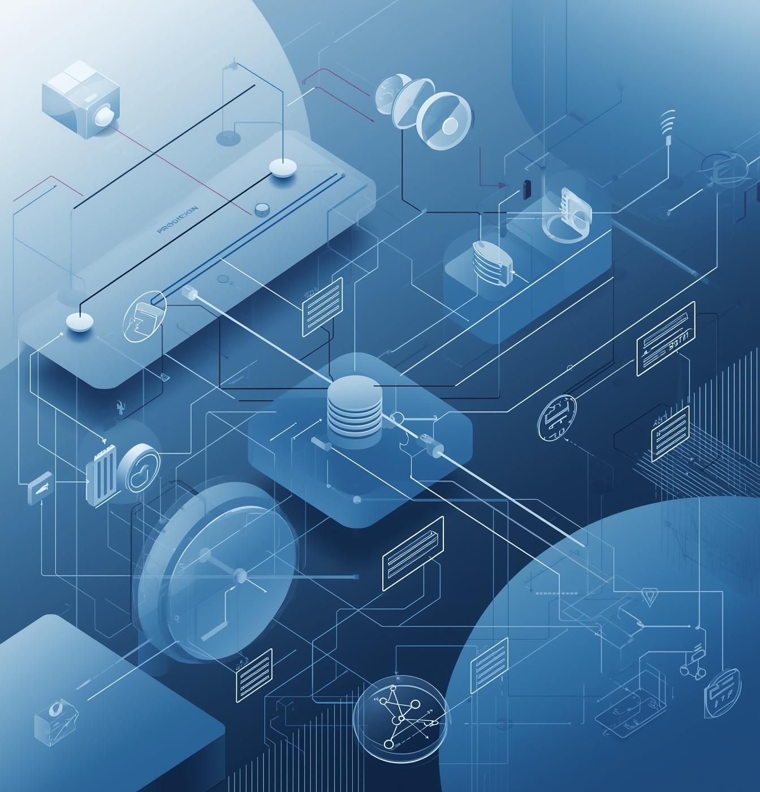

December 25
Production RAG Overview
Production RAG with LangFlow & Python

Slide 2
Why RAG Matters
Understanding the importance in production
RAG mitigates hallucination risks by ensuring control and traceability of AI outputs, while protecting private data through robust retrieval mechanisms, enhancing overall reliability and trustworthiness.

Slide 3
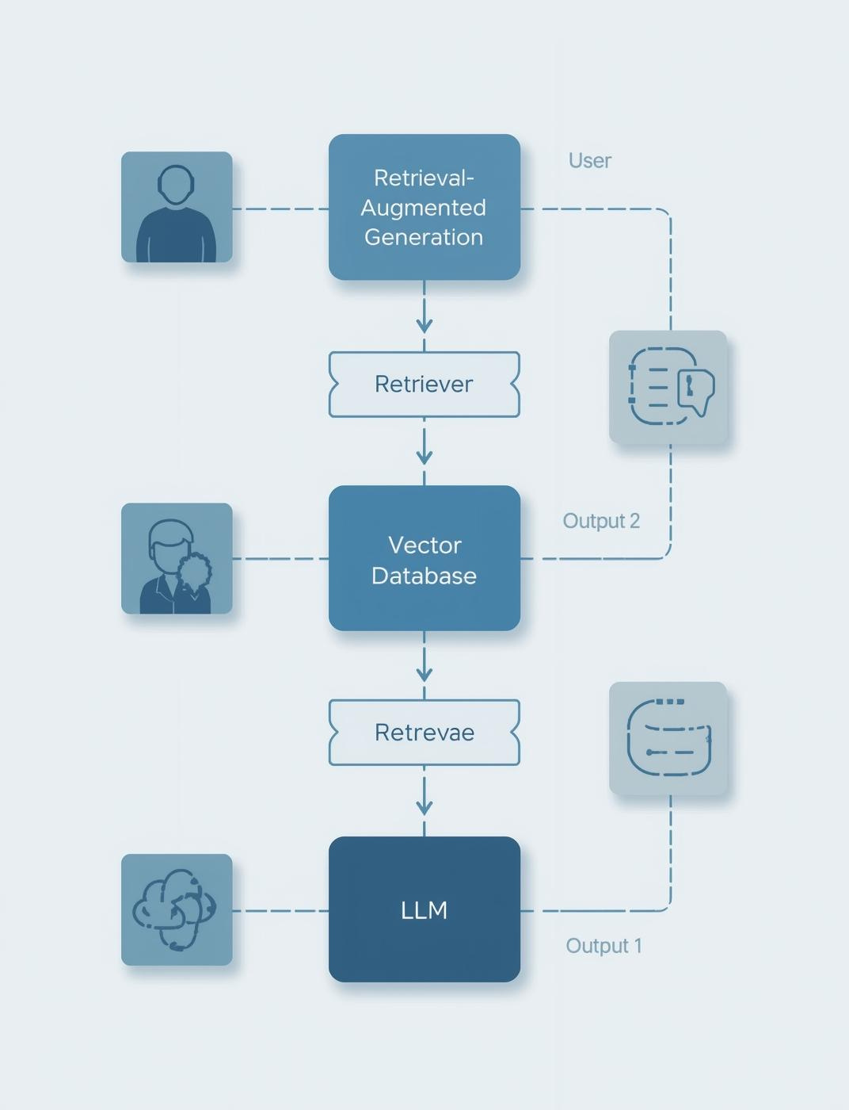
High-Level Architecture
The RAG architecture integrates key components ensuring seamless interaction between users, data retrieval, and language model outputs.

Slide 4
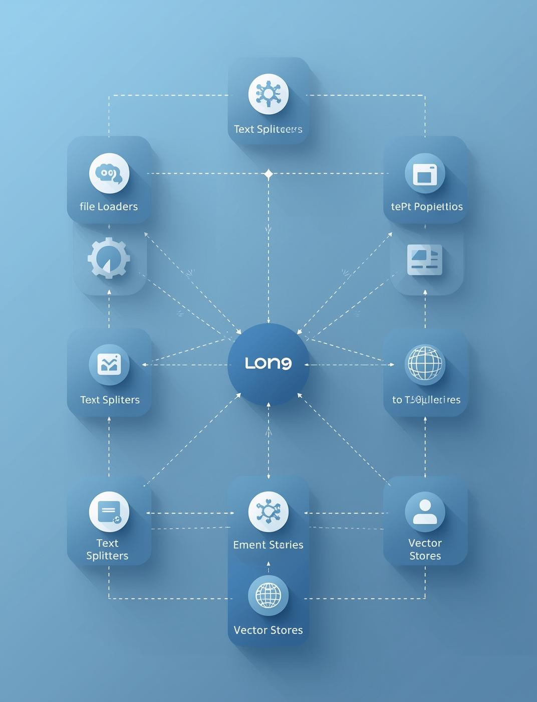
LangFlow Pipeline
The LangFlow visual pipeline orchestrates RAG components, facilitating seamless integration and enhancing the data processing workflow.

Slide 5
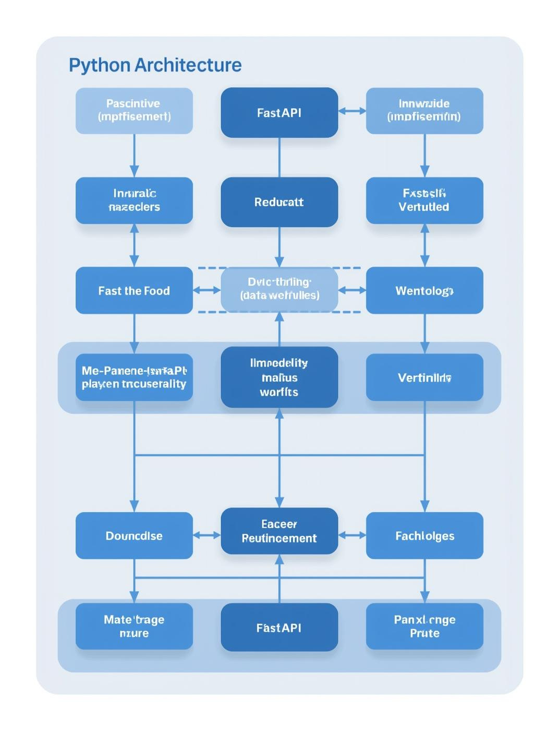
Python Backend
The backend leverages FastAPI for rapid deployment, handling embedding calls and retrieval logic seamlessly within the RAG architecture.

Slide 6
Data Ingestion
Preparing Data for Effective Processing
Effective data ingestion involves utilizing PDF and web loaders, implementing a robust chunking strategy, and maintaining comprehensive metadata to ensure high-quality input for the RAG system.

Slide 7
Embeddings & Vector DB
Understanding semantic search and filtering
Embeddings translate data into a numerical format, enabling efficient semantic search within a Vector Database, which facilitates rapid filtering and retrieval of relevant information.

Slide 8
Retriever & Prompt
Building Context for Effective Responses
The retriever employs Top-K retrieval to select relevant documents, constructing a prompt template that includes guardrails to ensure safe and accurate LLM outputs.

Slide 9
Generation & Evaluation
Understanding production checks and metrics
Ensuring answer accuracy is crucial; we monitor metrics like cost and latency to optimize performance, guaranteeing a reliable and efficient system throughout production.

Slide 10
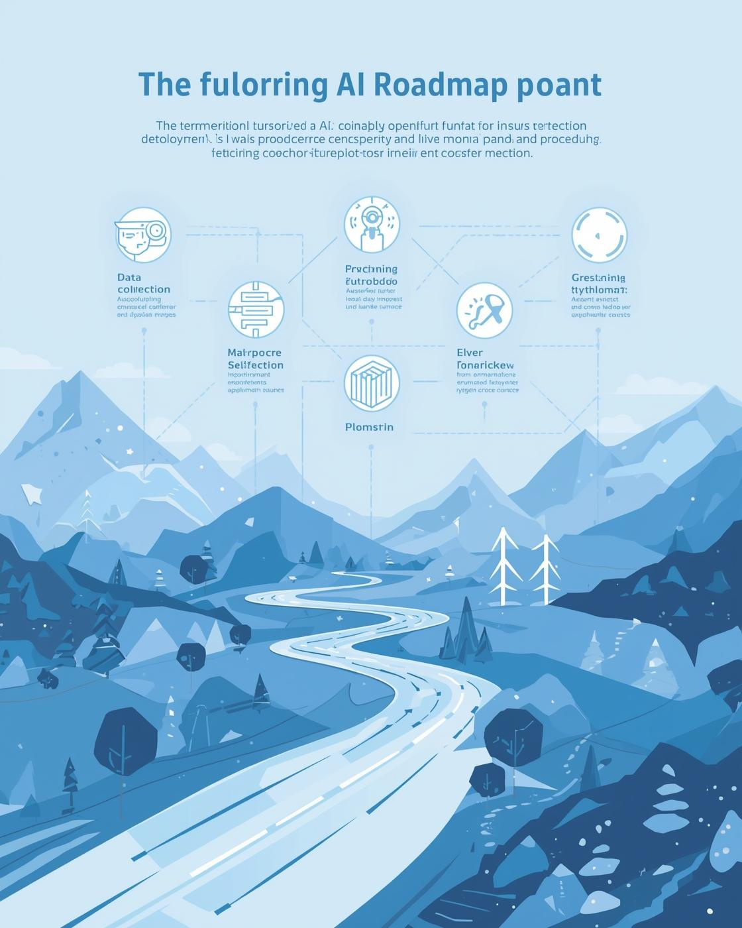
The final system integrates RAG with LangFlow and Python for scalable AI solutions, enabling seamless expansion and continuous improvements to meet evolving production demands.

